Slide 1
Getting Started with Microsoft Azure

Slide 2
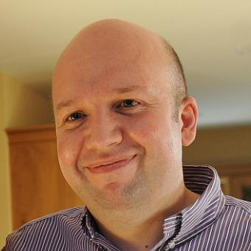

About me
Damien Flynn
Microsoft MVP: Cloud and Datacenter
Twitter
Email
LinkedIn
@damian_flynn
Technology@damianflynn.com
https://www.linkedin.com/in/damianflynn/

Slide 3

Welcome
CAN I VIEW THIS PRESENTATION AFTER THE WEBINAR?
Yes, this presentation is being recorded
A link to the recorded presentation will be sent to the email address you used to register

Slide 4
Getting Started with Microsoft Azure
DEMO

Slide 5
Summary and Next Steps:
Use the Azure portal to create and manage resources
Easily deploy resource from your IDE
Use Azure CLI and PowerShell to script and automate tasks
Get useful information on Azure.com

Slide 6

Thank you for joining us.
© 2016 Microsoft Corporation. All rights reserved. Microsoft, Windows, Windows Vista and other product names are or may be registered trademarks and/or trademarks in the U.S. and/or other countries.
The information herein is for informational purposes only and represents the current view of Microsoft Corporation as of the date of this presentation. Because Microsoft must respond to changing market conditions, it should not be interpreted to be a commitment on the part of Microsoft, and Microsoft cannot guarantee the accuracy of any information provided after the date of this presentation. MICROSOFT MAKES NO WARRANTIES, EXPRESS, IMPLIED OR STATUTORY, AS TO THE INFORMATION IN THIS PRESENTATION.

